Slide 1
Rockwell

Slide 2
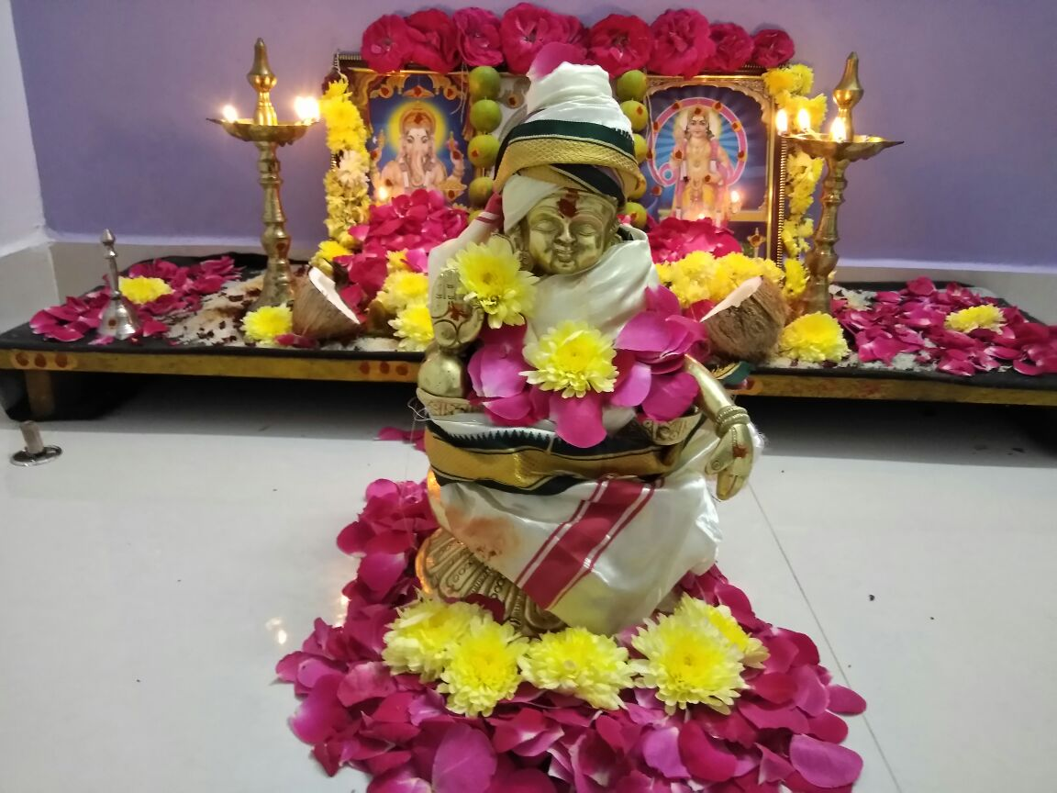
About ayyappa

Slide 3
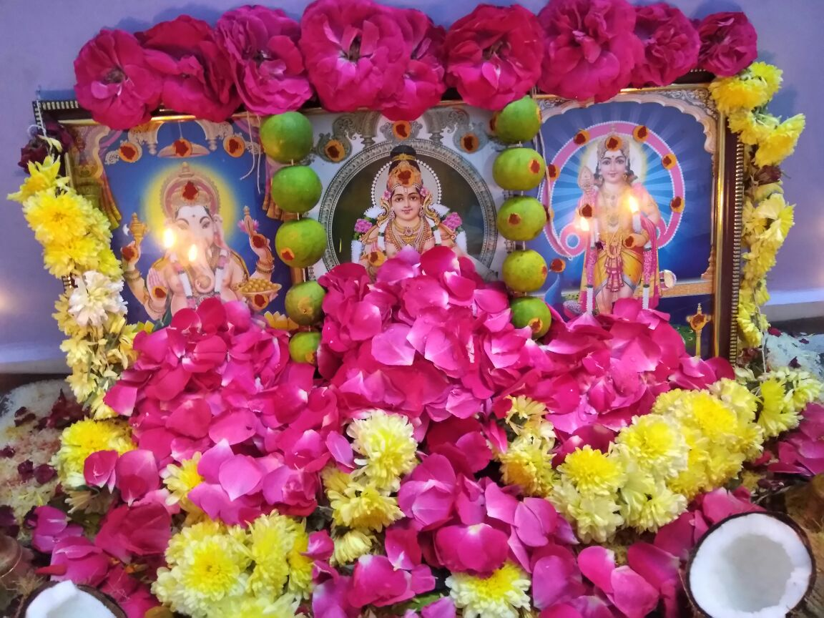
My father wears ayyappa mala dress and goes to shabarimala with guru swami

